Slide 1
Optimization Of Implementation Procedures For RES Electricity Generation Infrastructure Projects In The Baltic States
Dr.habil.sc.ing. Dagnija Blumberga
Ph.D. Ieva Pakere
M.sc.ing. Krista Laktuka

Slide 2
About the research
Latvia, Lithuania, Estonia
Finland, Norway, Sweden
Identify administrative procedures
Compare and asess
Conclusions and recommendations
Notes:
The research identifies and describes administrative procedures for implementing RES electricity generation infrastructure projects in the Baltic and Nordic countries.
The purpose of the research was to identify implementation process of RES electricity generation infrastructure projects in the Baltic States and Nordic countries and to:
compare the formal procedures, permitting process, other requirements, including spatial planning conditions and procedures, environmental impact assessment, as well as barriers which hinder the implementation of RES electricity generation infrastructure projects;
assess the critical points in the procedures needed for implementation of renewable energy power generation projects;
identify examples of good practice;
provide conclusions on the procedure for implementing RES electricity generation infrastructure projects in Latvia, Lithuania, and Estonia;
develop recommendations for more straightforward coordination procedures for RES electricity generation infrastructure projects, facilitating administrative procedures and removing obstacles in the Baltic States.

Slide 3
Profiles of the countries analysed
Overview of RES power profiles in each analysed country in 2019
Country | Installed capacity, MW | Produced energy, GWh | Produced energy, GWh | Share of final consumption, % | Installed capacity increase, MW | Installed capacity, MW | Produced power, GWh | Share of final consumption, % | Installed capacity increase, MW
 | Solar |  |  |  |  | Onshore wind
Lithuania | 103 | 91 |  | 0.8% | 39% | 534 | 1499 | 13.1% | 3%
Estonia | 74 | 48 |  | 0.6% | 303% | 316 | 687 | 8.1% | 2%
Latvia | 3 | 3 |  | 0.0% | 2900% | 78 | 154 | 2.3% | 1%
Finland | 222 | 149 |  | 0.2% | 171% | 2284 | 6535 | 8.4% | 12%
Sweden | 714 | 623 |  | 0.5% | 193% | 8681 | 19768 | 15.7% | 31%
Norway | 120 | 107 |  | 0.1% | 167% | 5212 | 5040 | 4.1% | 49%
Notes:
Sweden has the largest installed solar capacity (714 MW); however, it provides only 0.2% of final power consumption [23], while Lithuania has managed to meet 0.8% of its final electricity consumption with solar technologies [24]. Another analysed parameter is the increase of installed capacities during recent years (from 2015 to 2019) presenting the actual development trends. The highest figures are found in Latvia, which had almost no installed solar capacity in 2015 [25], while Finland's installed solar capacity increased from 17 MW in 2015 to 222 MW in 2019 [23].
Sweden had the largest installed onshore wind capacity in 2019, accounting for almost 16% of final energy consumption [26]. Lithuania has also achieved a high share of wind power generation compared to total final energy consumption [24]. The Nordic countries have achieved the highest growth in installed wind capacity in recent years, which could be the result of both support policies and an optimised approval and installation process [26], [27].

Slide 4
Primary criteria for comparing procedures
Implementation procedure
Timeline for implementation process
Complexity
Information availability
Impact of public opinion
Impact of municipality
Notes:
The comparison is based on defined and harmonised criteria for comparing administrative frameworks for the implementation of RES electricity generation infrastructure projects. Five main dimensions have been identified for procedure comparison (See Table 2) by considering the timeline, complexity, information availability, impact of public opinion, and local authorities (municipalities). Each of the analysed criteria includes one or several sub-criteria described below

Slide 5
General steps for RES project implementation and approval process

Slide 6
Timeline analyses
Standardisable processes
Non-standardisable processes
Territorial planning
Environmental impact assessment
Connection to the grid
Permit for Increasing Electricity Production Capacities or the Introduction of New Production Equipment
Building permit
Electricity trading permit

Slide 7
Average duration (months) of standardisable processes
Country | Microgeneration | Average/large solar plants | Average/large wind farms | Offshore wind farms
Latvia | 1 | 3 | 2 | 2,6
Lithuania | 0 | 3,6 | 3,3 | 4
Estonia | 2 | 6 | 6 | 6
Finland | 0,5 | 2 | 1,7 | 1,9
Norway | 0 | 2,7 | 4 | 2
Sweden | 2,3 | 2,3 | 4,3 | 4,7
Notes:
Uz mēnešiem

Slide 8
Average duration (months) of non-standardisable processes
Country | Microgeneration | Average/large solar plants | Average/large wind farms | Offshore wind farms
Latvia | 1 | 11,4 | 55,9 | 94
Lithuania | 1,6 | 17,3 | 62,6 | 85,2
Estonia | 1 | 24 | 60,6 | 85,2
Finland | 1 | 24 | 42,3 | 78,8
Norway | 3 | 21,3 | 27,4 | 88
Sweden | 3 | 14,3 | 41,6 | 91,3
Notes:
Uz mēnešiem

Slide 9
Number of involved institutions

Slide 10
Number of necessry documents

Slide 11
Accumulated knowledge, MW/inhabitants

Slide 12
Impact of municipality and society
 | Municipality impact evaluation |  | Society impact evaluation |  | Number of public discussions
Country | SPP | WF | SPP | WF | SPP | WF
Latvia | 3 | 1 | 0 | 2 | 0 | 3
Lithuania | 3 | 1 | 3 | 2 | 1 | 5
Estonia | 1 | 1 | 2 | 2 | 2 | 2
Finland | 3 | 2 | 2 | 3 | 2 | 2
Norway | 3 | 3 | 2 | 3 | 2 | 2
Sweden | 1 | 1 | 2 | 3 | 1 | 2
Notes:
Paskaidrot

Slide 13
Multi-criteria assessment results

Slide 14
Medium-term recommendations
Amendments to legislation
A single contact point
Enhancing the role of municipalities

Slide 15
Short-term recommendations to improve administrative processes

Slide 16
Microgeneration plants
Revise the legislation on capacities corresponding to the definition of microgeneration
Latvia - microgenerator - 11.1 kW, small-scale power plant up to 0.99 MW;
Lithuania – microgenerator – 30 kW, small-scale power plant up to 500 kW;
Estonia - microgenerator – 15 kW, small-scale power plant up to 1 MW.
Finland - microgenerator - 100 kVA, small power plant up to 2 MVA;
Norway - microgenerator - 100 kW, small power plant up to 1 MVA;
Sweden - microgeneration - 43.5 kW.
Should be determined in consultation with the national distribution and transmission system operators and the national regulatory authorities

Slide 17
Changes to the spatial planning framework
Determine the areas where wind farms are allowed to be installed when drawing up the municipality's territorial plan and/or detailed planning
Allocate a certain amount of land in each municipality for the installation of wind power plants
Detailed plans that already include areas where wind turbines are allowed to be located
Notes:
To require municipalities to determine the areas where wind farms are allowed to be installed when drawing up the municipality's territorial plan and/or detailed planning
Further research should be carried out to determine whether it is possible to stipulate in laws and regulations that all municipalities must allocate a certain amount of land for the installation of wind power plants
Detailed plans that already include areas where wind turbines are allowed to be located should undergo an environmental impact assessment during the development of the detailed plan
Establish that a detailed spatial plan drawn up by a municipality allows for the installation of wind turbines is the basis for granting a building permit.

Slide 18
Changes to the spatial planning and EIA framework
The public consultation on changes to the spatial planning and on the EIA are combined.
Allow municipalities to charge project developers for consultation and document examination.
Set a maximum number of rejections in the EIA screening procedure with clear criteria for the developer
Notes:
Following the Nordic experience, in this case, Finland, where the public consultation on changes to the spatial plan and the public consultation on the EIA are combined.
Set a maximum number of rejections in the EIA screening procedure with clear criteria for the developer as to why the report or screening has been rejected and why corrections should be made (in Lithuania).
Informative and explanatory information for municipal staff to clarify issues related to spatial planning and consider allowing municipalities to charge project developers fees for advice and review of documents.

Slide 19
Construction process:
Avoid a situation where all engineering structures are classified only according to capacity, without taking into account the specific technology, its size and the specifics of its installation;
Develope guidelines and/or additional information material for installing solar PV plants and wind parks at the national level.

Slide 20
Permits for the development of electricity production capacity and permits for the production of electricity from renewable energy sources
by creating a single point of contact: the need for such a permit could be automatically integrated;
by delegating all authorisation for solar and wind parks to the municipality: permits could be re-categorised as an application for the development of a wind or solar PV park project in the municipality.
facilitating administrative procedures: amend the existing legislation and reclassify "permit" as an " informative report", which would serve as information for statistical records

Slide 21
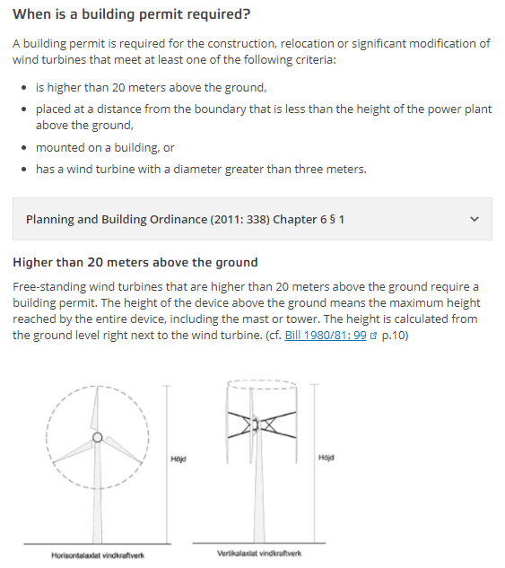
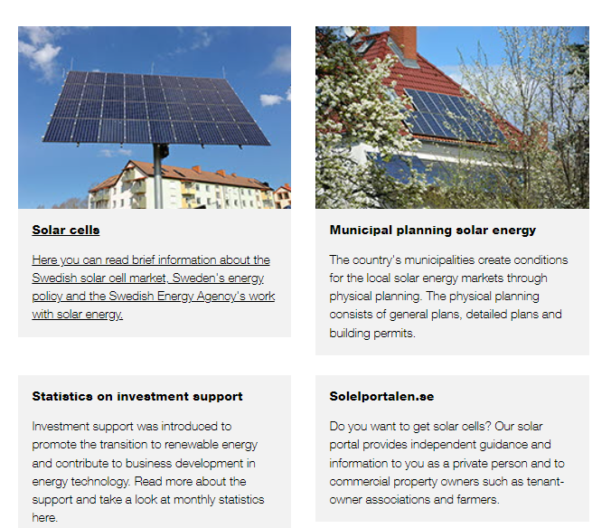
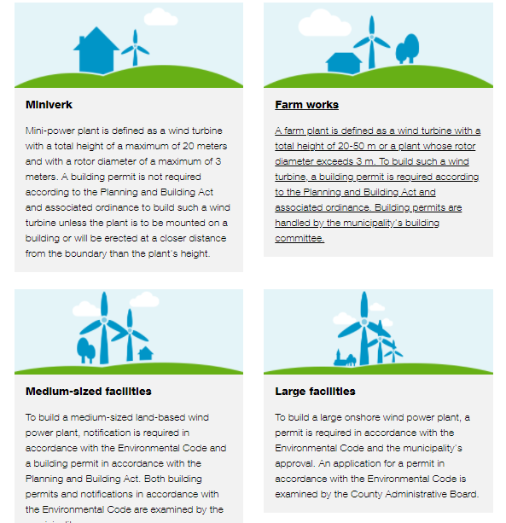
Guidelines for installing wind turbines and solar PV panels. Swedish experience

Slide 22

Digitalisation
Following the practice in Finland (Lupapiste service - https://www.lupapiste.fi/login/fi )
a single online system where all necessary permits and consultations, as well as tracking the progress of documents, can be done electronically on one platform.
Notes:
Following the practice in Finland (Lupapiste service - https://www.lupapiste.fi/login/fi ),
authors suggest that all Baltic States also think of a single online system where all necessary permits and consultations, as well as tracking the progress of documents, can be done electronically on one platform.

Slide 23
Offshore wind farms
Based on the information gathered about the Nordic experience, it can be suggested that one of the prerequisites for faster project delivery could be to not separate the licensing procedures for offshore wind farms from onshore wind farms, making them two disparate technologies licensed through entirely different procedures.

Slide 24
The study was prepared within the EUSBSR PA “Energy” activity framework with the support and co-financing of the EU Interreg Baltic Sea Region Transnational Cooperation Program 2014-2020. (https://www.em.gov.lv/en/energy-studies).
M.sc.ing. Krista Laktuka
e-pasts: Krista.Laktuka@rtu.lv;
P.hD. Ieva Pakere
e-pasts: Ieva.Pakere@rtu.lv

Slide 25
Amendments to legislation
Law of the Republic of Lithuania on Energy from Renewable Sources:
Such a legislative act summarising regulation for RES technologies can be seen as a facilitating factor for the development and installation of RES technologies and contributes to the transparency of the processes.

Slide 26
A single contact point:
availability of comprehensive and detailed information on the installation process of solar PV plants and wind farms;
a common approach and interpretation of legal provisions;
advice on the process and support in completing the necessary documentation;
accumulated knowledge and understanding of the project process and specificities, a common approach to dealing with non-standard situations, experienced staff.
In the long term, establishing a single point of contact could facilitate the development of wind and solar PV park projects and speed up their progress due to the accumulated knowledge and deeper understanding of the potential impacts of the projects

Slide 27
Enhancing the role of municipalities
A manual and guidelines prepared by the competent public authority for the use of municipal officials, explaining in detail the specifics and correct interpretation of the legislation related to the wind and solar PV plant installation process and the preferred progress flow of the project;
The establishment of national-level support mechanisms for municipalities and municipal officials to improve and strengthen the administrative process of project implementation;
Possible incentives could include introducing a one-time payment, where the project developer pays the municipality an amount of money determined by the national regulatory framework. The payment could be calculated as a percentage of the total project scope (installed capacity) or as a percentage of the electricity sold when the plant starts operation.

Slide 28
Criteria for comparing implementation procedures
Dimension | Criteria | Type of evaluation | Data source
Timeline of the implementation process | Time for standardisable process steps; | Quantitative | National legislation, regulatory documents, information from authorities'.
 | Time for non- standardisable process steps; | Quantitative | National legislation and regulatory documents, information from authorities', project descriptions
 | Total time for project implementation. | Quantitative | Realised project information
Complexity | Number of contact points (contact institutions); | Quantitative | National legislation and regulatory documents, information from authorities'.
 | Number of indirectly involved institutions. | Quantitative | National legislation and regulatory documents, information from authorities'.
 | Number of necessary documents to be prepared. | Quantitative | National legislation and regulatory documents, information from authorities'.
Information availability | Availability of public information | Qualitative | Expert evaluation based on available information
 | Accumulated knowledge on the project implementation. | Quantitative | Statistical data
Impact of public opinion | Number of public discussions to be carried out during the project implementation process; | Quantitative | National legislation and regulatory documents, information from authorities'.
 | The opportunity of local society to influence the implementation of RES projects. | Qualitative | Expert evaluation based on available information
Impact of local authority | The opportunity of the municipality to influence the implementation of RES projects. | Qualitative | Expert evaluation based on available information

Slide 29
Analysed projects and the timeline
Country | Project name, capacity |  | Timeline
Onshore wind projects
Norway | Raggovidda Wind Farm (45MW) | Raggovidda Wind Farm (45MW) | 2010 - 2014
Sweden | Sjisjka wind farm (78MW) | Sjisjka wind farm (78MW) | 2011-2012
Finland | Kalax wind park in Närpes(Fortum) (90MW) | Kalax wind park in Närpes(Fortum) (90MW) | 2017-2021
Estonia | Paldiski Onshore Wind Farm (22,5MW) | Paldiski Onshore Wind Farm (22,5MW) | 2008-2013
Latvia | Wind park Tārgale (58,8MW) | Wind park Tārgale (58,8MW) | 2011-2022
Latvia | Wind farm Latflora (50 MW) | Wind farm Latflora (50 MW) | 2008-2024
Lithuania | UAB Wind Farm in Akmenė one (75MW) | UAB Wind Farm in Akmenė one (75MW) | 2013-2021
Offshore wind projects
Norway | Havsul I (350MW) | Havsul I (350MW) | 2004-2009
Sweden | Lillgrund (110MW) | Lillgrund (110MW) | 1997-2007
Finland | Kemi Ajos (25MW) | Kemi Ajos (25MW) | 2006-2009
Estonia | Saare Wind Energy (1,400 MW) | Saare Wind Energy (1,400 MW) | 2015-2023
Latvia | No realized projects | No realized projects
Lithuania | No realised projects | No realised projects
Country | Project name, capacity | Timeline
Solar power projects
Country | Project | Timeline
Sweden | Nya Solevi | 2018-2019
Finland | Solar park in Nurmo | 2021-2022
Estonia | Tallin Utilitas solar power plants (10-50 kW) | 2019-2020
Estonia | solar plant in Pärnu - Eesti Gaas and Paikre OÜ | 2018-2019
Latvia | “Jurmalas siltums” solar power plant | 2018-2019
Latvia | Microgeneration of residential house | July – November, 2018
Lithuania | Elektrum Lietuva park in Klaipeda District(1,5MW) | 2020-2021

Slide 30
How important is each of criterion?

