Slide 1

ELBJAZZ FESTIVAL 2014
MAY 23rd + 24th
The integrative concept of the ELBJAZZ Festival and how it contributes to the destination factor in Hamburg
Hamburg – Harbor – Jazz!

Slide 2
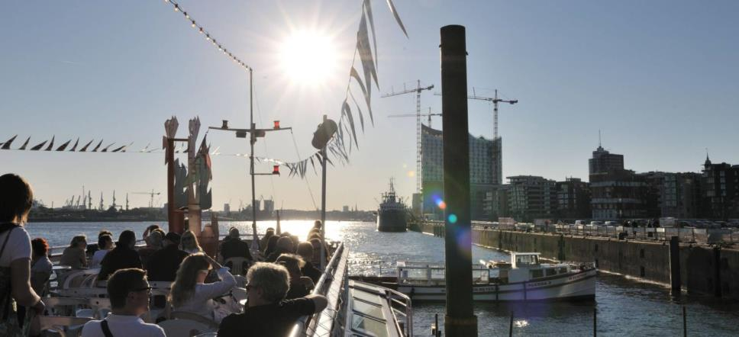
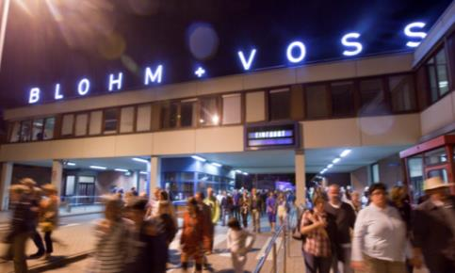
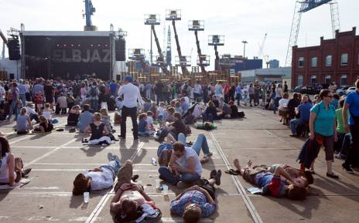
Hard Facts on ELBJAZZ

Slide 3
ELBJAZZ – A POWERFUL AND EMOTIONAL BRAND
The ELBJAZZ Festival attracts more than 20,000 visitors per year and creates an unforgettable musical experience, providing:
strong, emotional brand values
top-class quality concerts
state-of-the-art technical equipment
the positive, emotional setting of the Hamburg port
exclusive, unique concert locations
high national and international visibility resulting from collaboration with Hamburg Marketing and international cooperation partners.

Slide 4

VISITORS TO THE ELBJAZZ FESTIVAL
Age groups
Young, active target groups : 43% of visitors are aged 30 to 49,
25% are aged 18 to 29.
Gender distribution
From among the visitors, 55% are female and 45% male.
Places of residence & overnight stays
The majority of ELBJAZZ visitors are residents of the Hamburg Metropolitan Region. 35% of visitors live outside Hamburg, or travel from other European countries.
One third of visitors plan to stay in Hamburg for several days, averaging 2.4 overnight stays in the city.
As of May 2013,
Survey by Olaf Dose Marktforschung,
participants: 487 festival goers

Slide 5
VISITORS TO THE ELBJAZZ FESTIVAL
Additional features
Visitors to the ELBJAZZ Festival are educated, well established,
successful culture-loving professionals.
During their stay in Hamburg, ELBJAZZ Festival goers from outside the region also visit museums and exhibitions (26%), go sightseeing (26%), participate in city tours and boat trips (15%), and go shopping (36%) and dining (54%).
As of May 2013,
Survey by Olaf Dose Marktforschung,
participants: 487 festival goers

Slide 6
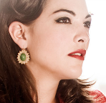
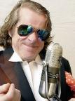
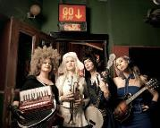
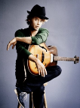
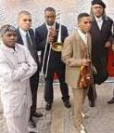
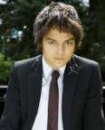
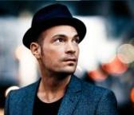
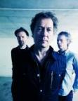
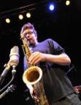

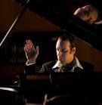
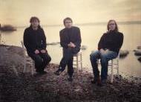
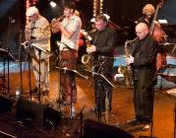
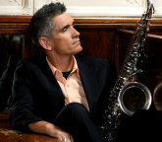
EXTRACTS LINE-UP 2010-2013

Slide 7
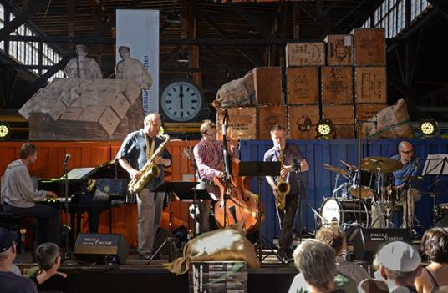
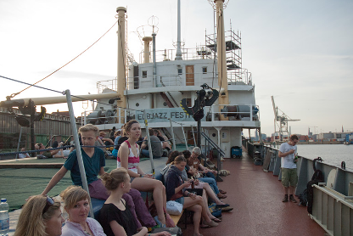
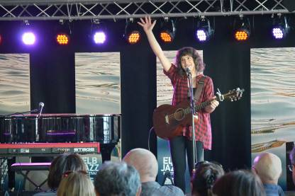
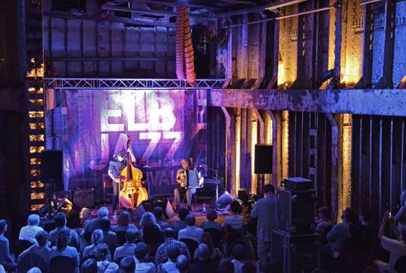
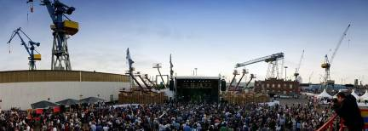
Venues and location partner

Slide 8
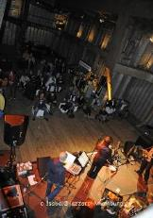
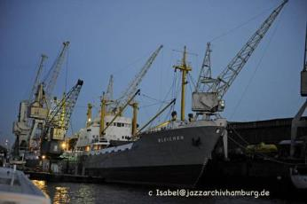
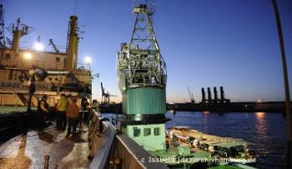
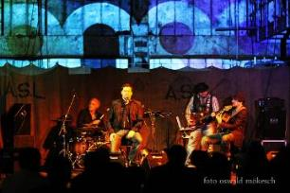
MS BLEICHEN AND HAFENMUSEUM
VENUES 2010-2013

Slide 9
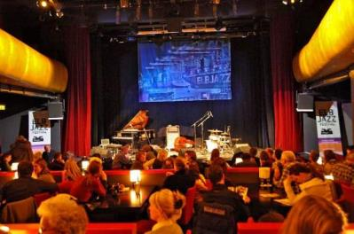
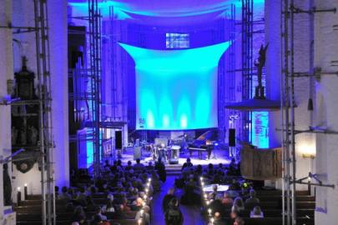
STAGE KEHRWIEDER THEATER AND ST. KATHARINEN
VENUES 2010-2013

Slide 10
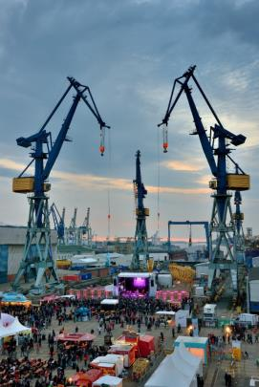
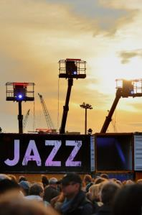
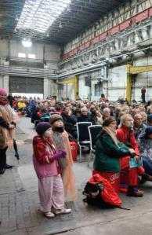
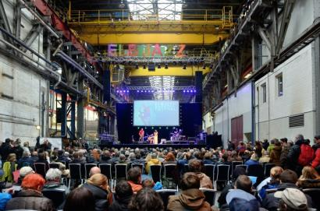
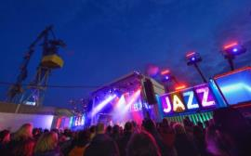
HAUPTBÜHNE, MASCHINENBAUHALLE AND AM HELGEN
VENUES 2010-2013
Foto: Stefan Malzkorn
Fotos: Christian Spahrbier

Slide 11
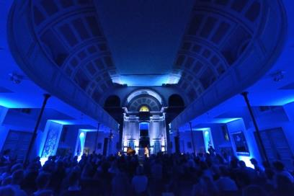
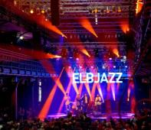
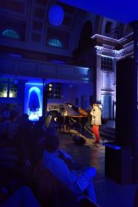
ST. PAULI KIRCHE AND FISCHAUKTIONSHALLE
VENUES 2010-2013
Fotos: Christian Spahrbier

Slide 12
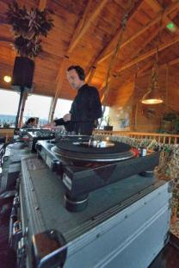
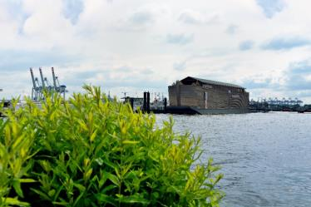
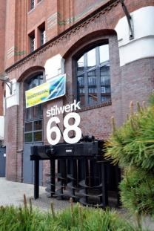
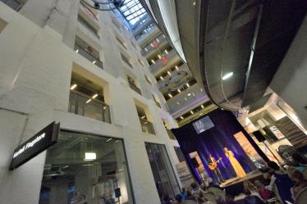
ARCHE NOAH AND STILWERK
VENUES 2010-2013
Fotos: Christian Spahrbier

Slide 13
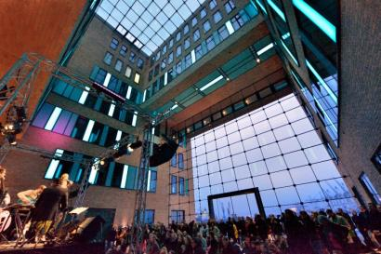
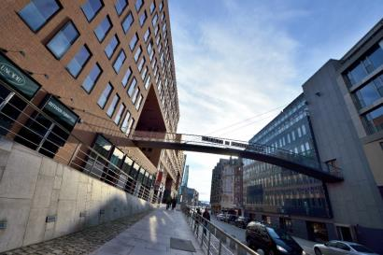
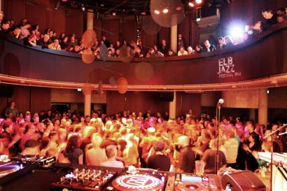
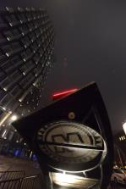
HOLZHAFEN ATRIUM AND MOJO CLUB
VENUES 2010-2013
Fotos:
Christian Spahrbier

Slide 14
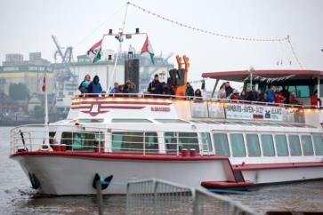
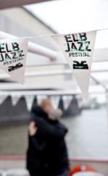
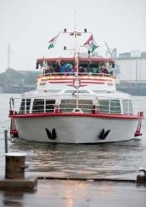
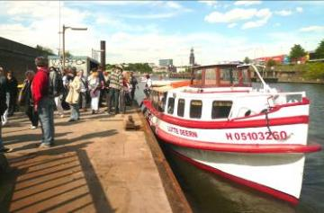
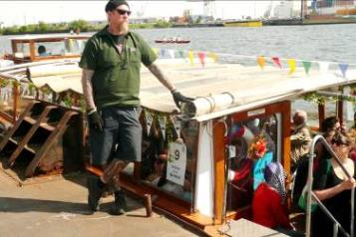





TRANSPORTATION
Transportation 2010-2013

Slide 15
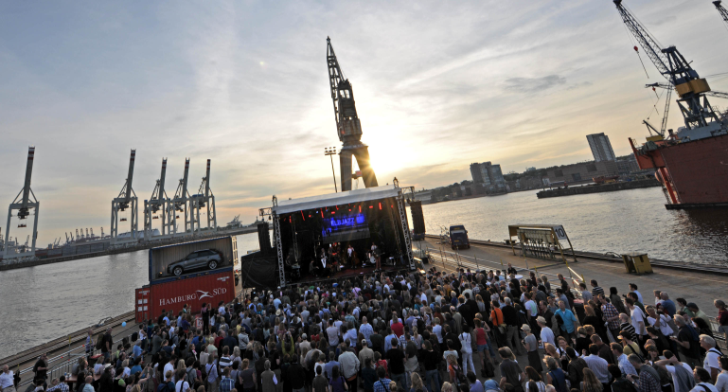
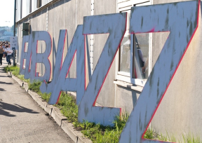


Marketing and Sponsoring collabos before and during ELBJAZZ

Slide 16


ACADEMY STAGE
Sponsored by

Slide 17




INTERNATIONAL STUDENT PROJECT „KEHRWIEDER“
Partner Countries 2013: Netherlands and Denmark

Slide 18


INTERNATIONAL FESTIVAL EXCHANGE
CJF & ELBJAZZ

Slide 19


FRAMEWORK PROGRAMME DURING THE FESTIVAL
Different local actors

Slide 20




COLLABORATION WITH THE CITY HALL
e.g. „Lange Nacht der Museen“

Slide 21





COLLABORATION WITH FINE ART MUSEUMS
e.g. „Lange Nacht der Museen“

Slide 22




LOBBY AND ADVOCACY
„Jazz Moves“ Berlin
ELBJAZZ press conference
2011
2013

Slide 23





A PERFORMANCE PROJECT WITH THALIA THEATER AND DIE ZEIT
Matthew Herbert‘s „One Day“

Slide 24





COLLABORATION WITH CITYMANAGEMENT HAMBURG
Shopping & Jazz on open Sundays

Slide 25


GUERILLA MARKETING IN THE CITY CENTRE WITH KOLLE REBBE
„The Jazzgame“

Slide 26


GUERILLA MARKETING IN THE CITY CENTRE WITH KOLLE REBBE
„The Jazzgame“

Slide 27

JAZZ ’N’ STAY – A COLLABORATION OF ELBJAZZ AND HAMBURG TOURISMUS

Slide 28



COLLABORATION WITH SPONSORS
Santa Fe Natural Tobacco

Slide 29

PARTNERS

Slide 30


COLLABORATION WITH ONLINE MEDIA PARTNER
Kultur-Port.de

Slide 31
To be continued
23rd | 24th May 2014
www.elbjazz.de

