Slide 1




RESEARCH RESULTS
Projected changes in costs and volumes and overheating risks Latvian construction industry 2022-2026.
2022 |

Slide 2

Purpose of the
research
To forecast changes in labour and building materials costs and possible overheating risks in the construction sector in Latvia in the period from 2022 to 2026 in order to be able to plan the potential costs of public construction procurements more efficiently and to assess possible price changes in the coming years
83 construction and economic experts involved:
Bank of Latvia; Ministry of Finance; The Competition Council; Latvian Union of Architects; Latvian Association of Electrical Engineers and Energy Builders; Latvian Union of Geotechnicians; JSC "Latvijas valsts meži"; Latvian Builders' Association; Latvian Traders Association; Partnership of Latvian Construction Contractors; Latvian Union of Civil Engineers; the Ministry of Environmental Protection and Regional Development; University of Latvia; RTU; Ventspils University of Applied Sciences; RISEBA, AS "Sakret Holdings"; AS "SEB banka"; AS "Swedbank", SIA "Citrus Solutions"; Ogre Municipality Construction Board; "Ostas Celtnieks" Ltd.; Latvian State Roads, Ltd. "Limbažu ceļi"; association "Latvijas ceļu būvājs", SIA "Optimera Latvia", etc..
Researc conducted:
2022
in May, June and July
Methodology:
Updated forecasting methodology (initial 2018), which includes both expert, statistical and combined forecasts.
Researchers:
Scientists in the field of economics of the research organization InnoMatrix

Slide 3

Content
Cost and volume forecasts
Factors affecting costs
Assessment of the risks of overheating

Slide 4
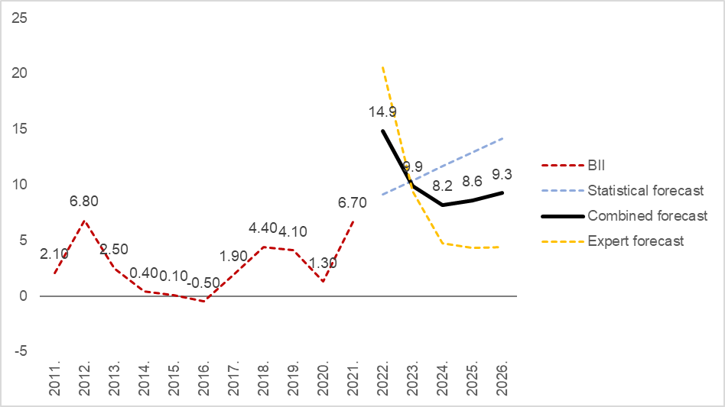
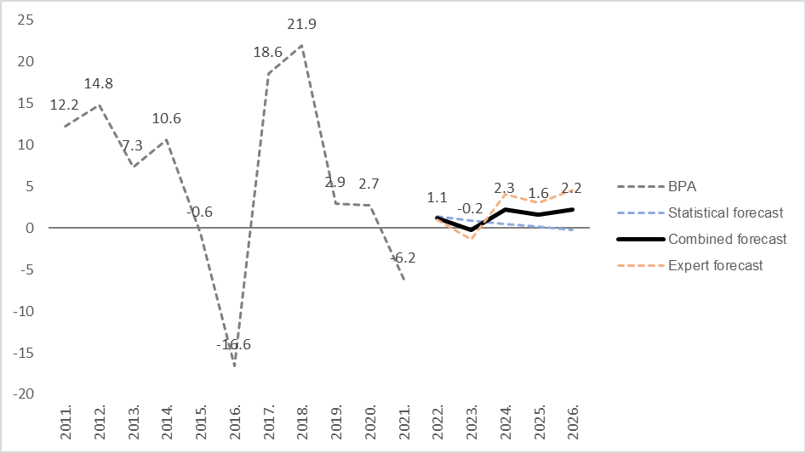
2022 construction production growth forecast: 0.9% increase in volume and 20.5% in costs on an annual basis

Slide 5
Marked variations between forecasts of changes in construction output and costs
Changes in construction output compared to the previous year
2020 | 2021 | 2022 | 2023 | 2024 | 2025 | 2026
+2.7% | -6.2%
Statistical forecast → |  | +1.3% | +0.9% | +0.5% | +0.1% | -0.2%
Combined forecast → |  | +1.1% | -0.2% | +2.3% | +1.6% | +2.2%
Expert forecast → |  | +0.9% | -1.4% | +4.0% | +3.0% | +4.6%
Changes in construction costs compared to the previous year
2020 | 2021 | 2022 | 2023 | 2024 | 2025 | 2026
+1.3% | +6.7%
Statistical forecast → |  | +9.2% | +10.4% | +11.6% | +12.9% | +14.1%
Combined forecast → |  | +14.9% | +9.9% | +8.2% | +8.6% | +9.3%
Expert forecast → |  | +20.5% | +9.4% | +4.7% | +4.4% | +4.4%

Slide 6
The relatively fastest cost increase is expected in the construction of buildings
 | 2022 | 2023 | 2024 | 202 | 2026.
Expert forecast of changes in construction costs of residential buildings | +25.1% | +14.3% | +8.7% | +8.6% | +7.8%
Expert-examination of changes in construction costs of non-residential buildings | +26.6% | +15.3% | +9.0% | +8.6% | +8.2%
Expert forecast of changes in construction costs of roads and highways | +23.3% | +9.7% | +6.7% | +6.0% | +4.7%
Expert forecast of changes in construction costs of railways and metros | +25.0% | +12.5% | +8.5% | +5.0% | +3.5%
Expert forecast of changes in the cost of construction of bridges and tunnels | +25.0% | +11.0% | +7.5% | +5.0% | +3.5%
Expert-examination of changes in the construction costs of urban management infrastructure objects | +21.3% | +18.8% | +8.0% | +5.8% | +4.5%
Expert-examination of changes in the cost of specialized construction works | +17.5% | +12.0% | +9.3% | +5.3% | +4.7%
Expert forecast of changes in the cost of architectural and engineering services, technical inspection and analysis | +14.0% | +7.6% | +8.8% | +6.4% | +7.6%

Slide 7
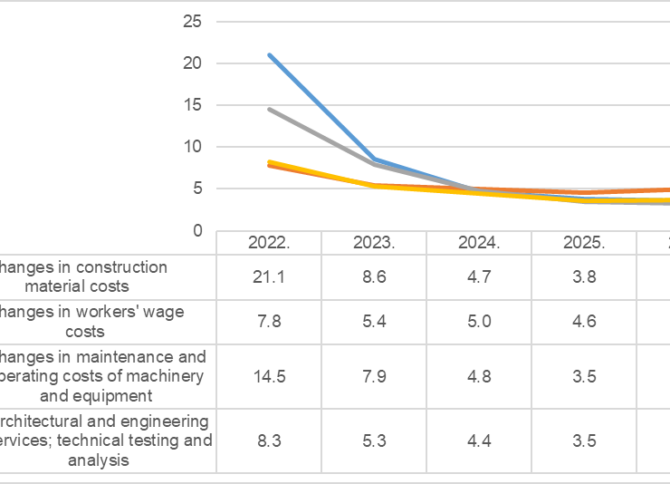
A markedly high cost increase in 2022 is expected for building materials and costs of machinery and equipment
Identified high cost increase in ALL types of resources!

Slide 8
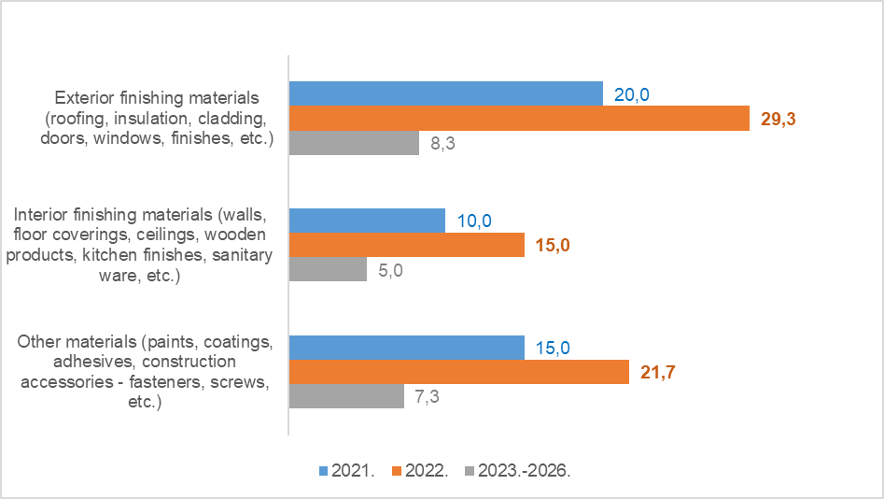
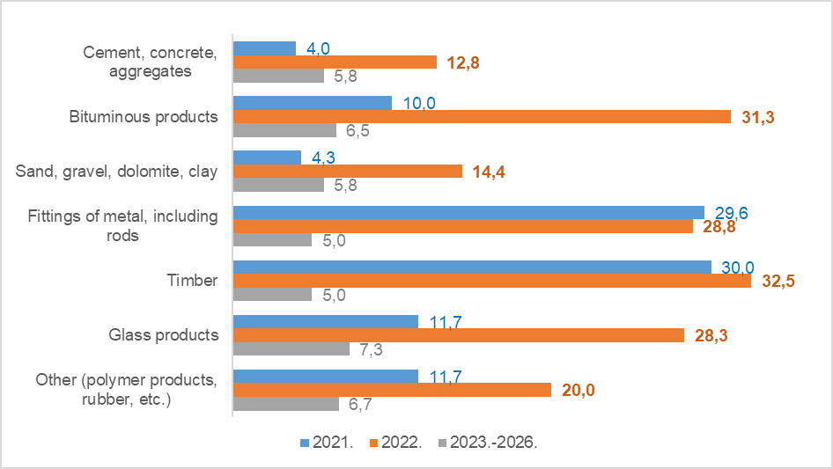
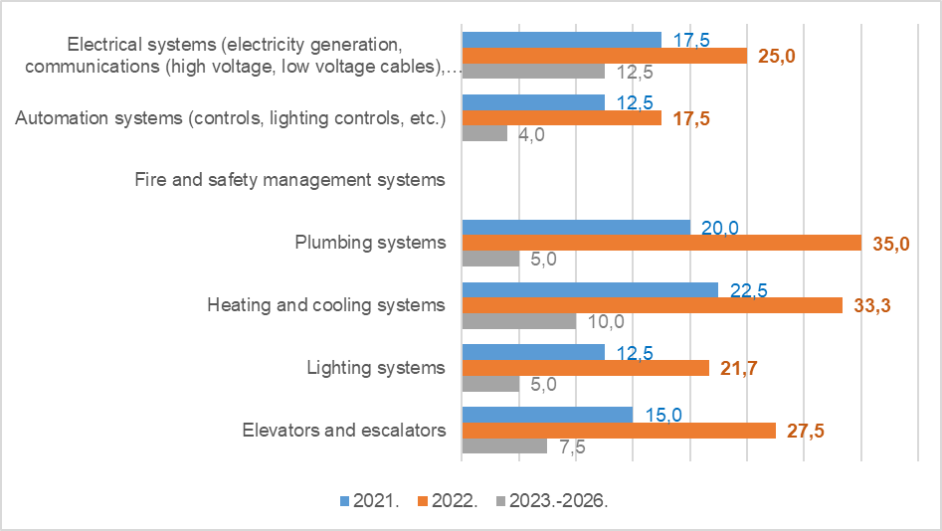
The cost of the most significant building materials
Experts predict a significant increase in the cost of basic building materials in 2022 and a drop in cost growth in the period 2023-2026 in all positions
The most significant increase in costs specifically for exterior finishing materials. Cost stabilization is planned for 2023-2026.

Slide 9
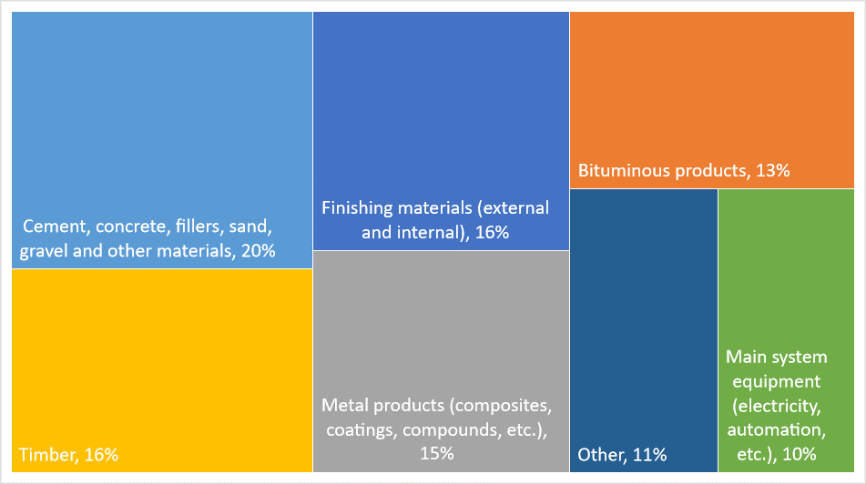
1/3 in the sale of building materials is formed by the costs of timber and metal products

Slide 10
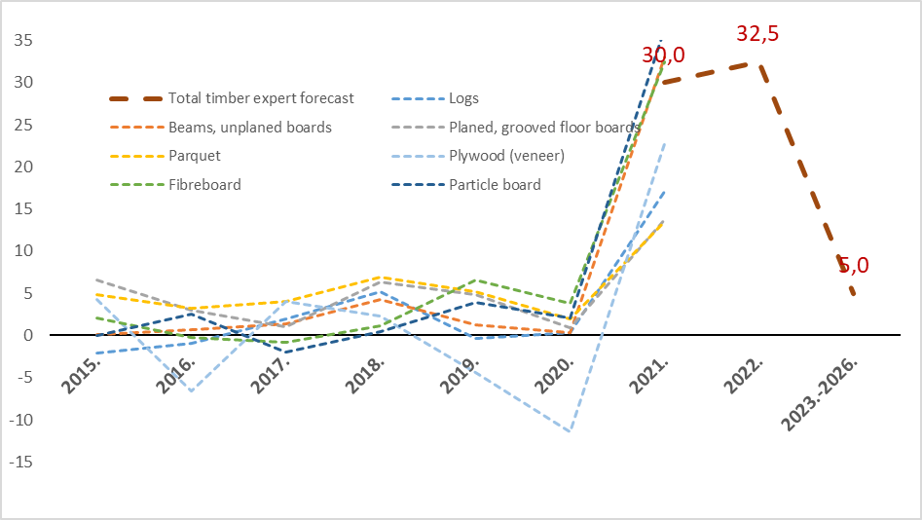
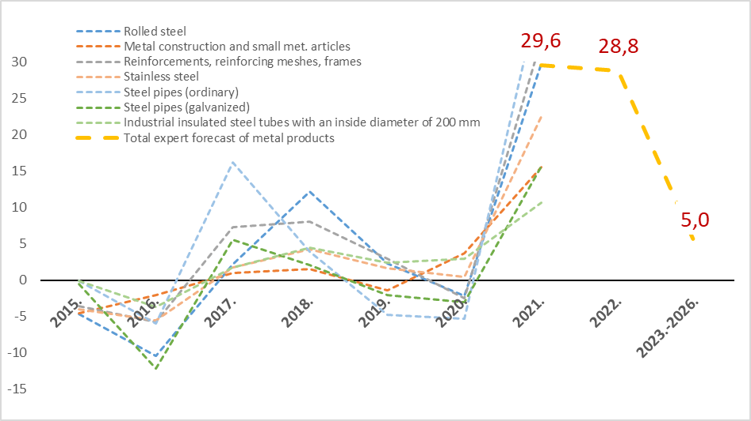
Price dynamics of selected timber and metal products

Slide 11
Factors affecting costs 2022

Slide 12
Factors affecting changes in the cost of building materials
 | The most important factors affecting the cost of building materials | Average expert evaluation
1 | Average annual price of metal products in Latvia | 8,51
2 | Average annual timber price in Latvia | 8,07
3 | Average annual price of energy resources in Latvia | 8,00
During the year, the impact of metal and timber on the cost of building materials has intensified. A significant leap in the impact of energy prices.
Specific problems – the need to look for new delivery routes.
The volume of construction is no longer such a significant factor as the prices of materials and energy. In the construction of urban infrastructure, higher sensitivity to the global impact of COVID-19.

Slide 13
Factors influencing changes in the cost of machinery and equipment
 | The most important factors affecting the cost of machinery and equipment | Average expert evaluation
1 | Average fuel price in Latvia | 8,33
2 | Average annual price of energy resources in Latvia | 7,92
3 | Competition concentration indicators in the machinery and equipment market in Latvia | 6,22
A new factor with medium impact is the lack of competition in the market for machines and mechanisms.
Specific factors are problems with the availability of spare parts and machines and mechanisms of individual brands.

Slide 14
Factors affecting changes in labour costs
 | Main factors affecting labour costs | Average expert evaluation
1 | Construction volume in Latvia | 7,33
2 | Level of wages and salaries in the construction sector in EU countries | 7,29
3 | EU labour demand in the construction sector | 6,94
The impact of unique events - COVID-19, Rail Baltica, combating the shadow economy and digitalisation - on labour costs has been assessed as mediocre.
Specific problems – lack of specialists in certain professions, mid-level management, complexity of attracting guest workers and an increase in the amount of requirements.
The construction of transport facilities is more sensitive to labour demand in the construction sectors of other EU countries.

Slide 15
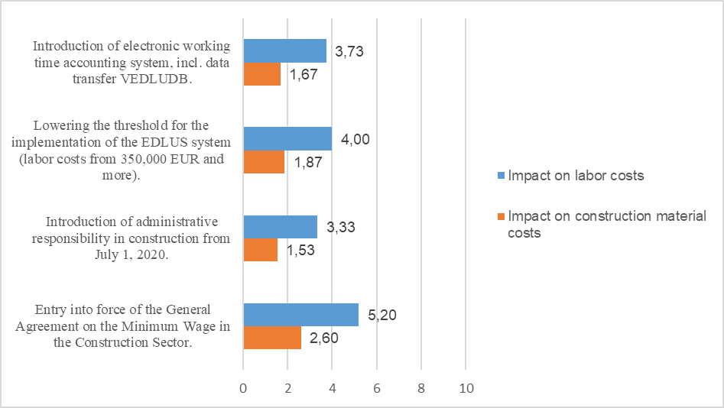
The impact of combating the shadow economy

Slide 16
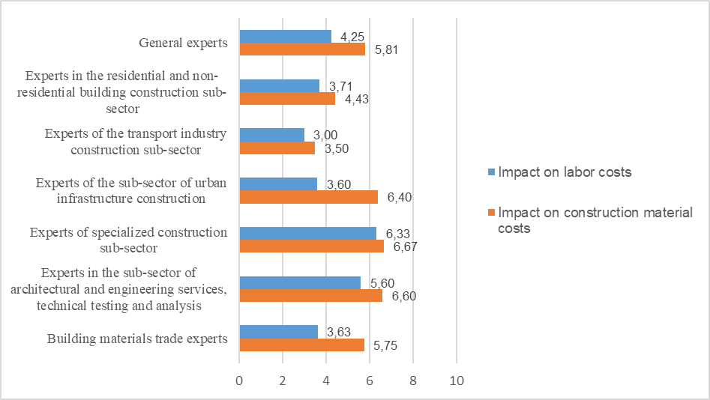
Impact of COVID-19

Slide 17
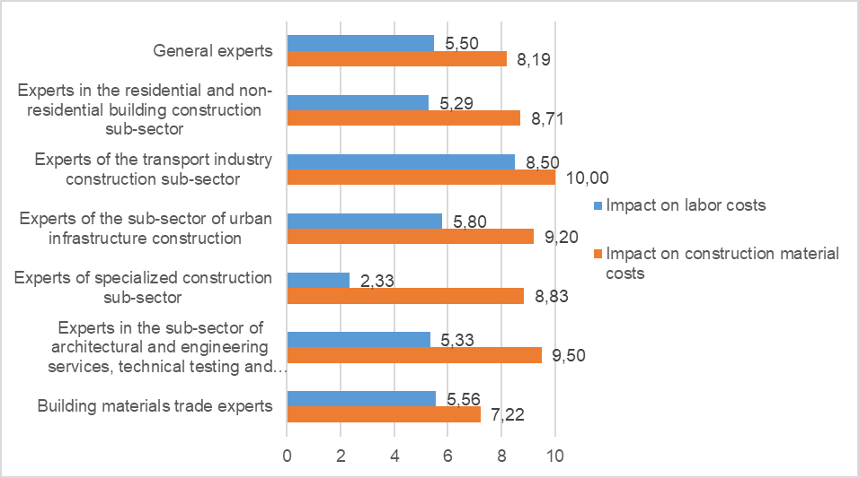
The influence of the Russo-Ukrainian war

Slide 18

Assessment of potential overheating of Latvian construction in 2022

Slide 19
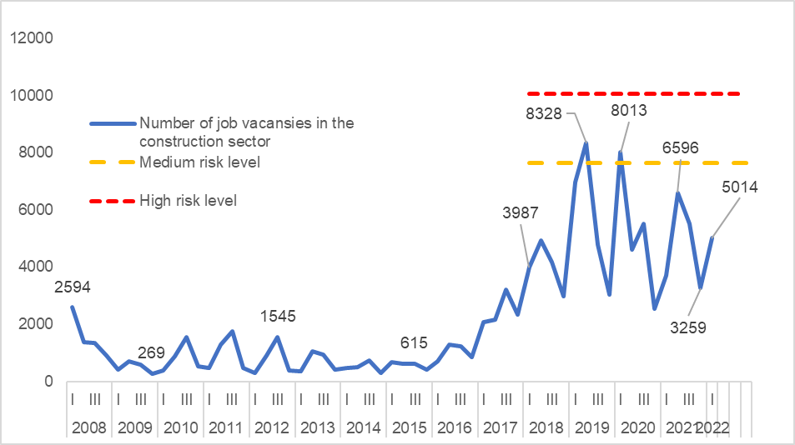
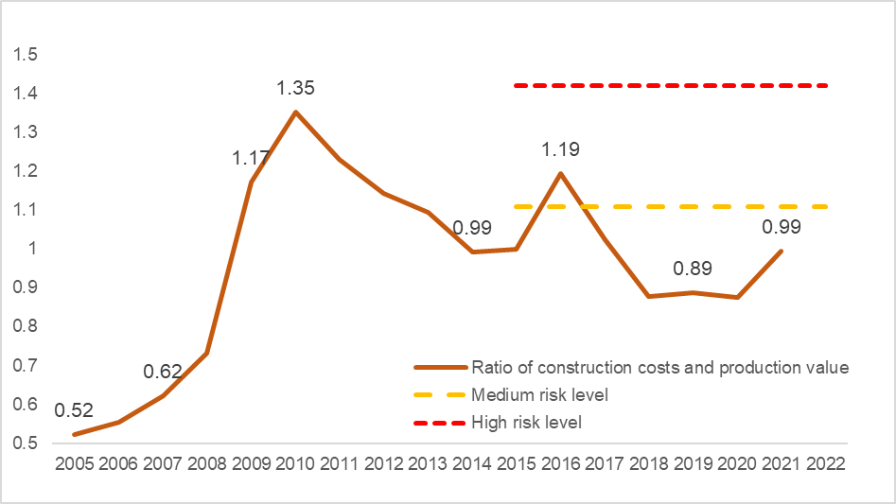
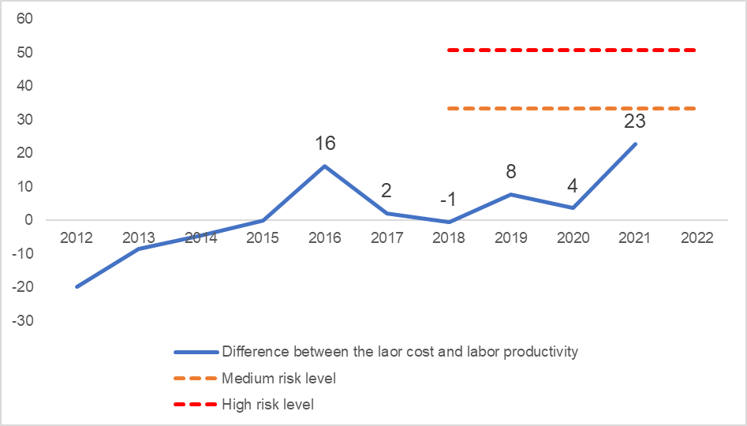
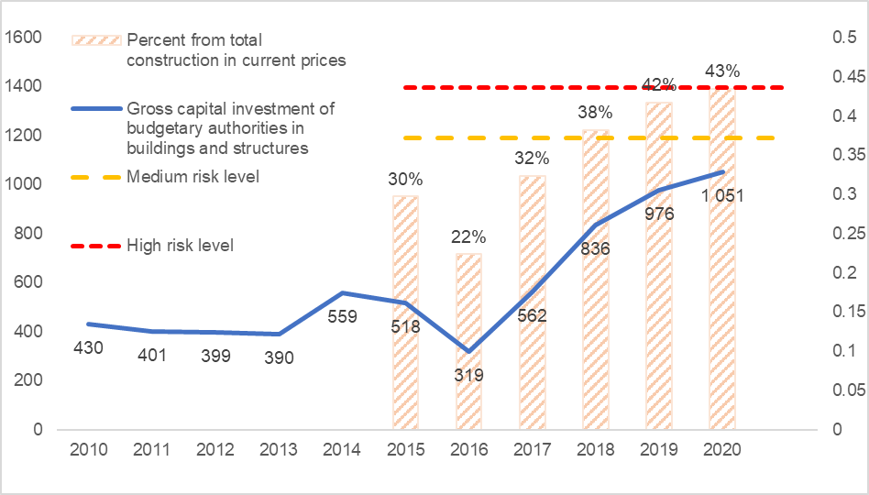
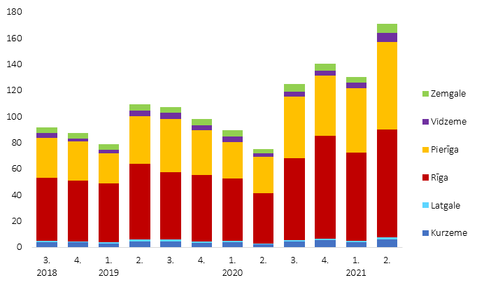
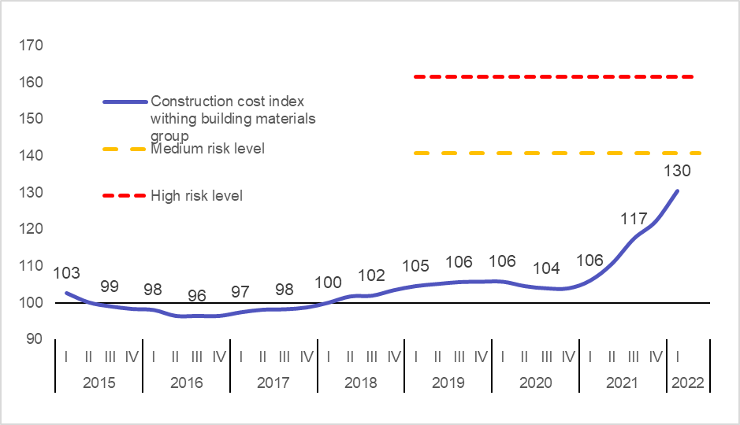
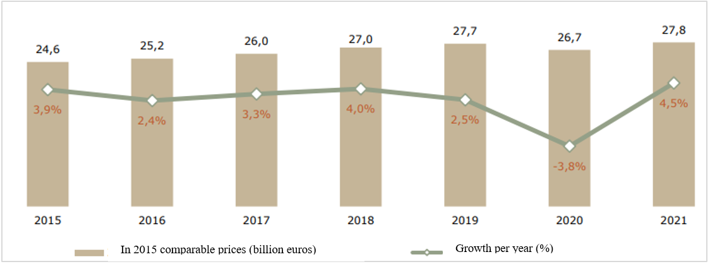
7 overheating risk indicators

Slide 20
Construction Overheating Risk Index–
0.66 for medium risk and 0.45 for high risk
Of the seven indicators included, the weighted average of their actual value is 66% of the limit of the average risk of overheating and 45% of the high limit.
Of the seven indicators examined, three are close to the overheating threshold assessed by experts – the volume of housing loans, GDP growth rate and capital investment in buildings and structures by budgetary authorities. The other four indicators are at the currently safe level or with a tendency to reduced risk.

Slide 21
Proposals
Competition authorities to analyse market concentration indicators in the trade sector of machinery and equipment and to develop measures to promote competition in order to reduce the costs of machinery and equipment.
Facilitate recruitment procedures for foreign labour and reduce bureaucratic barriers (waiting times required, wage requirements, etc.) in order to reduce labour cost jumps.
To provide support to companies in attracting new supply partners of raw materials, building materials and mechanisms to countries outside the countries involved in the Russo-Ukrainian war.
Develop a measure to slow down the lending of housing, if their volume goes to 200-250 mil. eur per quarter, while at the same time facilitating the redirection of loans to housing outside Riga and Pierīga.
Continue the measures taken to combat the shadow economy and develop new ones, taking into account the temporary tendency in the construction sector to increase the share of the shadow economy.
To develop the research methodology by reducing the number of questions in expert surveys, performing a more detailed analysis of overheating indicators and creating online tools for monitoring indicators characteristic of the construction industry.

Slide 22
Thank you!
Projected changes in labour and building materials costs and assessment of overheating risks in the construction sector in Latvia in 2022-2026.
2022 |

