Slide 1
Economic relations between Latvia and Russia/Belarus/Ukraine
24.2.2023
Avots: CSP

Slide 2
THE MAIN TRADING PARTNER OF LATVIA – THE EU COUNTRIES
LATVIA’S EXPORT STRUCTURE
%
LATVIA’S IMPORT STRUCTURE
%

Slide 3
EXPORTS OF LATVIAN GOODS BY REGIONS – exports to the EU and third countries are increasing; to a lesser extent to the CIS
Russia
1 185
1 140
253
672
EU
8 641
14 674
Asia
871
1 130
at current prices, m EUR
2019
2022a
279
570
48
57
26
51
Source: CSB; a – assessment of the Ministry of Economics
3
Notes:
The EU has been Latvia's main foreign trade partner for many years.
Since the annexation of Crimea in 2014, foreign trade in almost all commodity groups, except for energy resources, has decreased.
It should be taken into account that foreign trade statistics are presented in actual prices (including inflation), so the increase resulted from both price and volume growth. Please pay attention to the orange circles, as the next slide contains the same data, only at constant prices, minus the effect of inflation.

Slide 4
EXPORTS OF LATVIAN GOODS BY REGIONS – exports to the EU and third countries are increasing; to a lesser extent to the CIS
Russia
1 185
894
253
527
EU
8 641
10 387
Asia
871
886
at constant prices, 2019 = 100,
m EUR
2019
2022a
279
447
48
45
26
40
Source: CSB; a – assessment of the Ministry of Economics
4
Notes:
Komentārus, tēzes

Slide 5
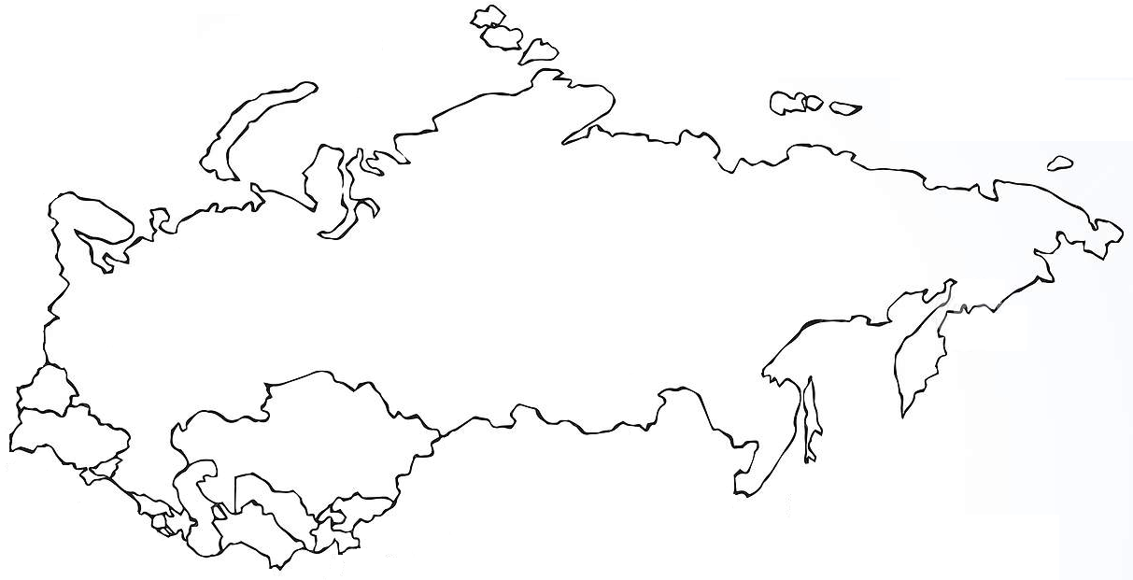
EXPORTS AND IMPORTS OF LATVIAN GOODS TO CIS COUNTRIES, UKRAINE, AND GEORGIA
at current prices, m EUR
2019
2022a
(% of total exports/ imports in 2022)
Russia
Exports Imports
(5.5%) (7.1%)
Mineral products (natural gas) 33%
Iron and steel 20%
Exports Imports
(0.9%) (1.2%)
Beverages 35%
Mechanisms 13%
Electrical appliances 11%
1 185
1 140
1 081
1 860
Mineral products (natural gas) 55%
Iron and steel 8%
192
180
320
314
Beverages 26%
Mechanisms 14%
Pharmaceuticals 10%
BY
Exports Imports
(1.7%) (1%)
UA
KZ
152
185
226
273
GE
Exports Imports
(0.2%) (0.03%)
AM
AZ
Exports Imports
(0.5%) (0.2%)
44
48
6
9
Exports Imports
(0.1%) (0.01%)
Exports Imports
(0.1%) (0.01%)
55
100
11
59
7
21
3
3
17
22
1
4
Source: CSB; a – assessment of the Ministry of Economics
5
Notes:
We carefully monitor the development of foreign trade with the countries of the region to assess potential attempts to circumvent the sanctions imposed on Russia by exporting goods to Russia through other countries of the region.
It should be taken into account that foreign trade statistics are presented at current prices (including inflation), so the increase resulted from both price and volume growth.
Please pay attention to the orange circles, because the next slide contains the same data, only at constant prices, minus the effect of inflation.

Slide 6
EXPORTS AND IMPORTS OF LATVIAN GOODS TO CIS COUNTRIES, UKRAINE, AND GEORGIA
at constant prices, 2019 = 100, m EUR
2019
2022a
(% of total exports/ imports in 2022)
Russia
Exports Imports
(5.5%) (7.1%)
Mineral products (natural gas) 33%
Iron and steel 20%
Exports Imports
(0.9%) (1.2%)
Beverages 35%
Mechanisms 13%
Electrical appliances 11%
1 185
894
1 081
1 420
Mineral products (natural gas) 55%
Iron and steel 8%
192
141
320
240
Beverages 26%
Mechanisms 14%
Pharmaceuticals 10%
BY
Exports Imports
(1.7%) (1%)
UA
KZ
152
145
226
208
GE
Exports Imports
(0.2%) (0.03%)
AM
AZ
Exports Imports
(0.5%) (0.2%)
44
38
6
7
Exports Imports
(0.1%) (0.01%)
Exports Imports
(0.1%) (0.01%)
55
78
11
45
7
16
3
2
17
17
1
3
Source: CSB; a – assessment of the Ministry of Economics
6
Notes:
Analyzing the data at constant prices, it is evidently visible that the volume of trade with Russia has decreased more rapidly than the increase with the other countries of the region.

Slide 7
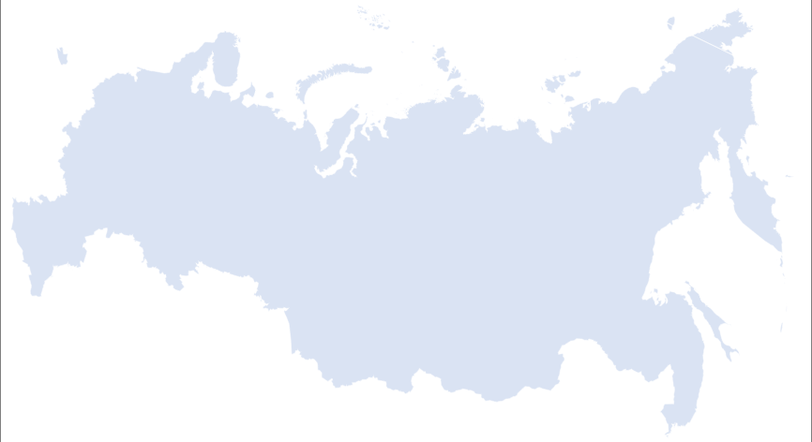
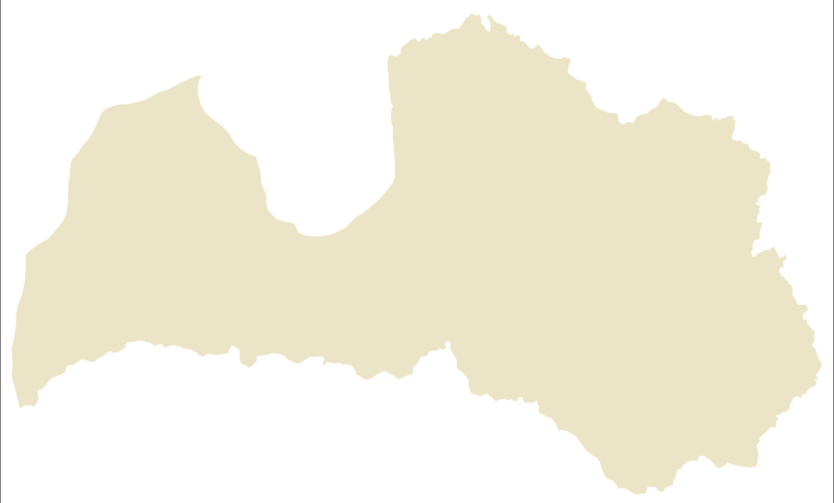
Latvia-RUSSIA foreign trade: exports are dominated by beverages, imports – by mineral products
TOP EXPORT GOODS=>
<= TOP IMPORT GOODS
2021
2022
2021
2022
 | mEUR | %
Beverages | 304 | 25
Mechanisms, devices | 187 | 16
Pharmaceuticals | 95 | 8
Electrical appliances | 138 | 11
 | mEUR | %
Beverages | 340 | 29
Mechanisms, devices | 158 | 13
Pharmaceuticals | 112 | 9
Electrical appliances | 88 | 7
 | mEUR | %
Mineral products, incl. natural gas | 6 234 389 | 35 22
Iron and steel | 459 | 26
Wood, its products | 149 | 8
Cereals | 28 | 2
 | mEUR | %
Mineral products, incl. natural gas | 1 046 489 | 57 27
Iron and steel | 122 | 7
Wood, its products | 97 | 5
Cereals | 79 | 4
7
Notes:
Izdalīt atsevišķi minerālajiem

Slide 8
Latvia-BELARUS foreign trade – exports are relatively diversified, imports are dominated by wood
TOP EXPORT GOODS=>
<= TOP IMPORT GOODS
2021
2022
2021
2022
 | mEUR | %
Pharmaceuticals | 25 | 13
Optical devices | 24 | 13
Mechanisms, devices | 95 | 12
Plastic | 22 | 12
 | mEUR | %
Pharmaceuticals | 29 | 16
Optical devices | 25 | 14
Plastic | 17 | 9
Used textiles | 17 | 9
 | mEUR | %
Wood, its products | 277 | 60
Plastic | 37 | 8
Mineral products | 21 | 4
Iron and steel | 17 | 4
 | mEUR | %
Wood, its products | 199 | 40
Animal, vegetable fats | 49 | 16
Plastic | 26 | 9
Optical devices | 14 | 5
8

Slide 9
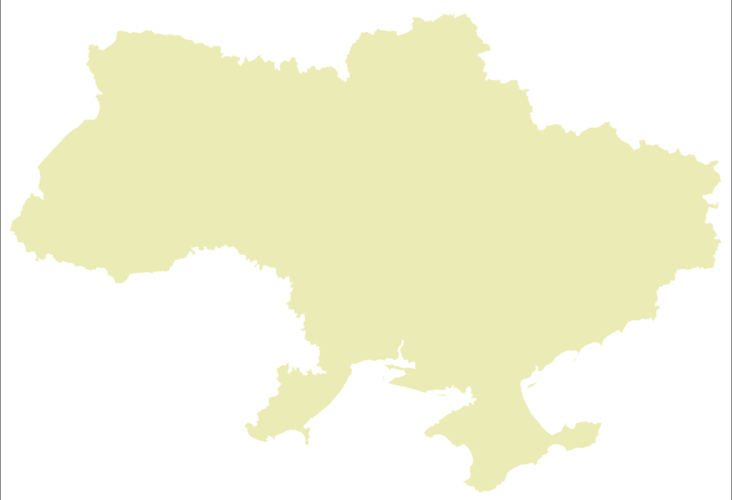
Latvia-UKRAINe foreign trade – exports are growing rapidly, imports are relatively diversified
TOP EKSPORTA PRECES =>
<= TOP IMPORTA PRECES
2021
2022
2021
2022
 | mEUR | %
Pharmaceuticals | 42 | 18
Beverages | 36 | 16
Fertilizers | 15 | 7
Mechanisms, devices | 14 | 6
 | mEUR | %
Unclassified goods | 203 | 39
Mineral fuel | 115 | 22
Beverages | 23 | 4
Meat, fish products | 22 | 4
 | mEUR | %
Iron and steel | 41 | 18
Organic chemical compounds | 20 | 9
Wood, its products | 19 | 8
Paper, cardboard, their products | 17 | 8
 | mEUR | %
Mixed chemical products | 56 | 20
Oil plant seeds | 23 | 8
Wood, its products | 21 | 7
Iron and steel | 19 | 7
9

Slide 10
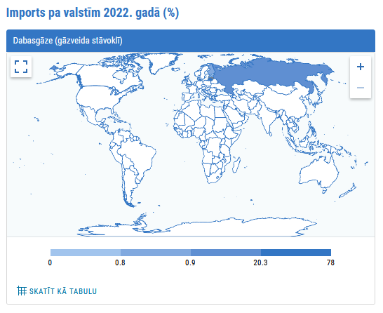
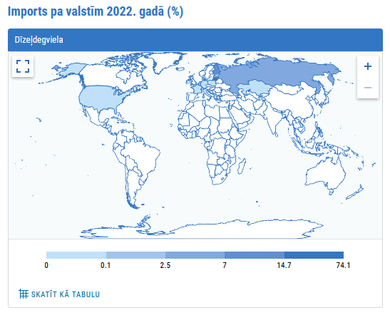
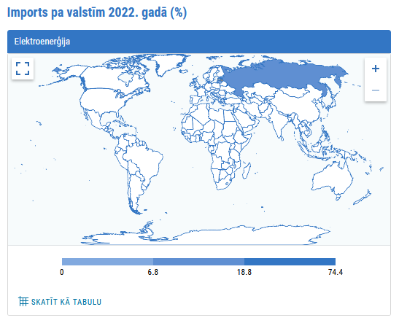
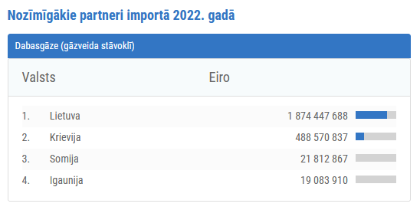
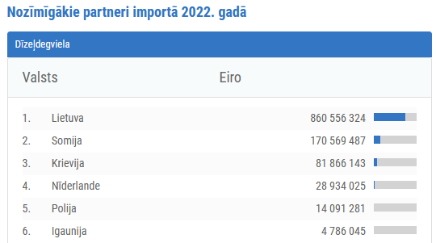
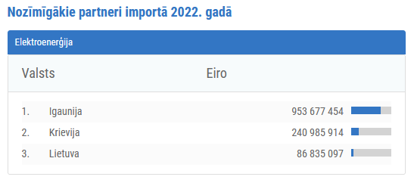
IMPORTS OF ENERGY PRODUCTS - the share of Russia and Belarus is shrinking significantly
NATURAL GAS (IN GASEOUS STATE)
DIESEL FUEL
ELECTRICITY
10

Slide 11
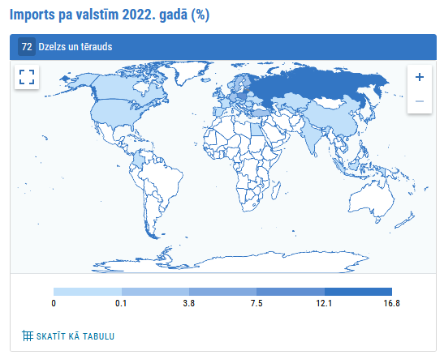
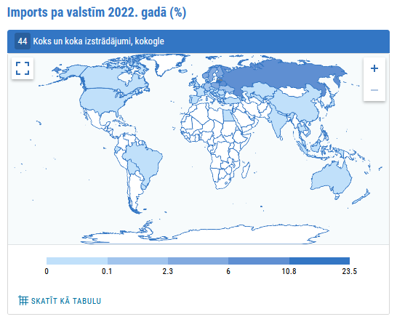
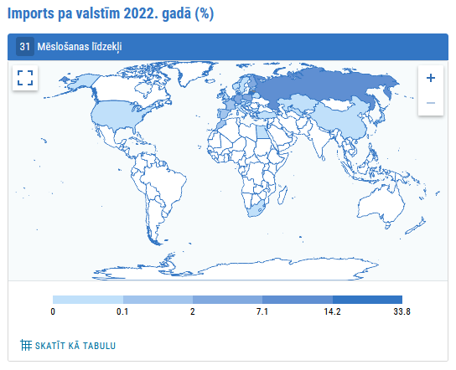
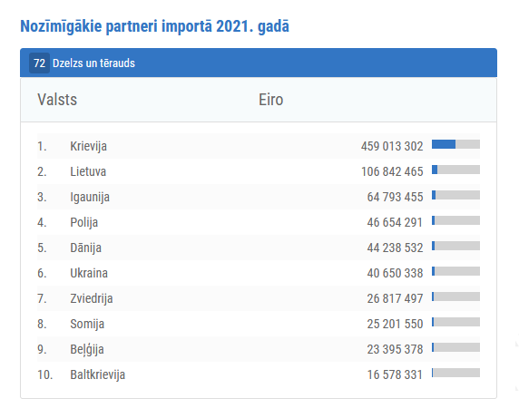
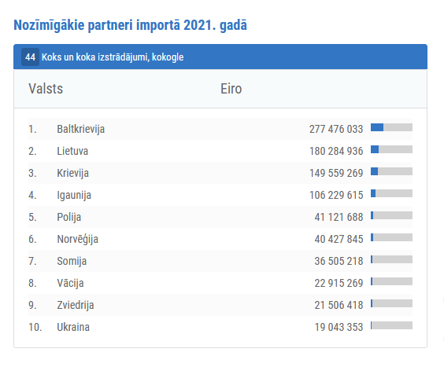
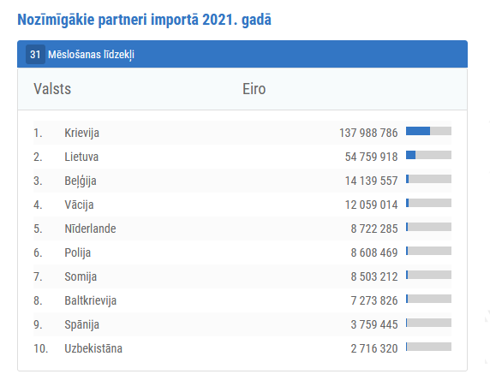
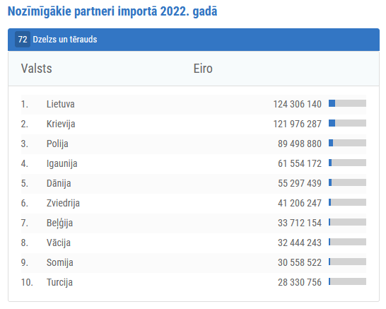
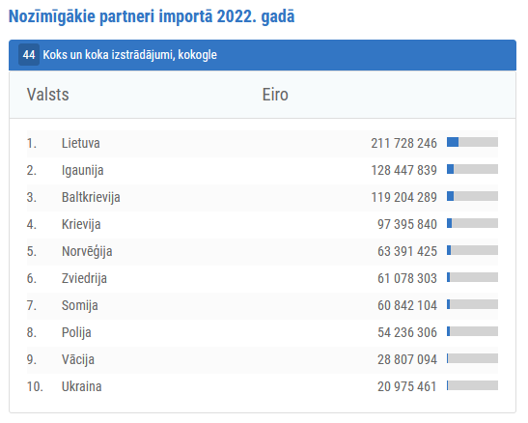
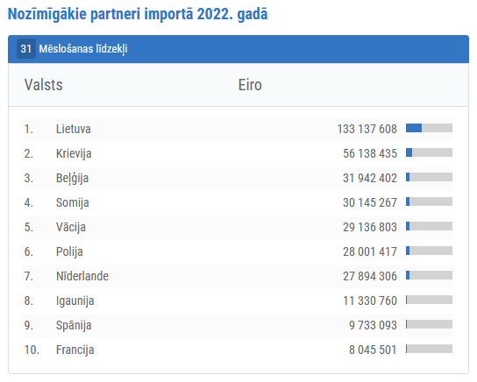
IMPORTS OF RAW MATERIALS – INCREASINGLY diversified
IRON AND STEEL
WOOD, ITS PRODUCTS
FERTILIZERS
11

Slide 12
SANCTIONED GOODS AND NEW SUPPLY MARKETS
Imports of natural gas thousand TJ
Imports of flat iron and steel rolls thousand tons
Imports of complex fertilizers thousand tons
Imports of wood and wood products thousand tons
LV consumption in 2022
42 thousand TJ
LV consumption in 2022
164 thousand tons
LV consumption in 2022
122 thousand tons
2022
2022
2022
2022
Source: CSB
12
Notes:
The main groups of goods where Latvia faced complications in the new geopolitical conditions are natural gas, because we historically imported large quantities of iron and steel products from Russia, as well as mineral fertilizers, which were re-exported from Crete/Belarus to other countries through Latvia, as well as wood and its products.
Thanks to the active work of the previous government, alternative supply options have been found and natural gas reserves in Latvia are currently sufficient and in line with seasonal consumption, albeit at a higher price.
Iron and steel supply products are more diversified. Currently, due to the slowdown in the construction sector, a decrease in the volume of imports can be observed. Nevertheless, in cooperation with industry associations, we are confident that there will be no shortage of resources.
The consumption of agricultural mineral fertilizers in Latvia is quite stable at around 120 thousand tons per year. Thus, even though import volumes have decreased rapidly and have not been compensated by deliveries from other countries, the volume required for Latvia's internal consumption is ensured.
The decrease in the import of wood and its products was partly compensated by the JSC Latvia’s State Forests, increasing the volume of auctions of felled wood, and the stabilization of the situation in the markets is also beneficial.

Slide 13
The number of Russian/Belarus exporting and importing companies is rapidly DECLINING
EXPORTS
number of companies
IMPORTS
number of companies
RUSSIA
BELARUS
RUSSIA
BELARUS
13

Slide 14
THANK YOU!
Ministry of Economics
Address: Brīvības iela 55, Rīga, LV-1519 Telephone: +371 6 7013 100 Fax: +371 6 7280 882 E-mail: pasts@em.gov.lv
Homepage: www.em.gov.lv
Twitter: @EM_gov_lv, @siltinam
Youtube: http://www.youtube.com/ekonomikasministrija
Facebook: http://www.facebook.com/atbalstsuznemejiem

